Slide 1
Subject : Pattern Recognition Unit-1 Introduction of PR
Prepared By- Mrs. P. S. Bahalkar

Slide 2
Patterns and Features
What is Pattern Recognition?
Pattern recognition is the process of recognizing patterns by using a machine learning algorithm. Pattern recognition can be defined as the classification of data based on knowledge already gained or on statistical information extracted from patterns and/or their representation. One of the important aspects of pattern recognition is its application potential.

Slide 3
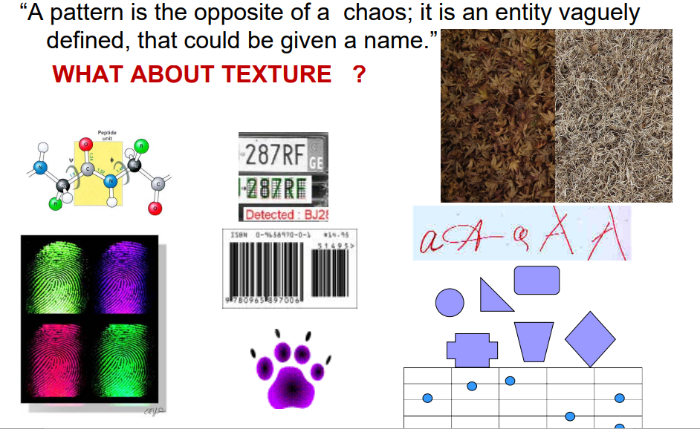
What is pattern?

Slide 4
Examples:
Speech recognition, speaker identification, multimedia document recognition (MDR), automatic medical diagnosis.
In a typical pattern recognition application, the raw data is processed and converted into a form that is amenable for a machine to use. Pattern recognition involves the classification and cluster of patterns.

Slide 5
Conti..
In classification, an appropriate class label is assigned to a pattern based on an abstraction that is generated using a set of training patterns or domain knowledge. Classification is used in supervised learning.
Clustering generated a partition of the data which helps decision making, the specific decision-making activity of interest to us. Clustering is used in unsupervised learning.

Slide 6
Features
Features may be represented as continuous, discrete, or discrete binary variables. A feature is a function of one or more measurements, computed so that it quantifies some significant characteristics of the object.
Example: consider our face then eyes, ears, nose, etc are features of the face. A set of features that are taken together, forms the features vector.

Slide 7
Example
In the above example of a face, if all the features (eyes, ears, nose, etc) are taken together then the sequence is a feature vector([eyes, ears, nose]). The feature vector is the sequence of a feature represented as a d-dimensional column vector. In the case of speech, MFCC (Mel-frequency Cepstral Coefficient) is the spectral feature of the speech.

Slide 8
Pattern recognition possesses the following features:
Pattern recognition system should recognize familiar patterns quickly and accurate
Recognize and classify unfamiliar objects
Accurately recognize shapes and objects from different angles
Identify patterns and objects even when partly hidden
Recognize patterns quickly with ease, and with automaticity.

Slide 9
Training and Learning in Pattern Recognition
Learning is a phenomenon through which a system gets trained and becomes adaptable to give results in an accurate manner. Learning is the most important phase as to how well the system performs on the data provided to the system depends on which algorithms are used on the data.
The entire dataset is divided into two categories, one which is used in training the model i.e. Training set, and the other that is used in testing the model after training, i.e. Testing set.

Slide 10
Conti..
Training set:
The training set is used to build a model. It consists of the set of images that are used to train the system.
Training rules and algorithms are used to give relevant information on how to associate input data with output decisions.
The system is trained by applying these algorithms to the dataset, all the relevant information is extracted from the data, and results are obtained.
Generally, 80% of the data of the dataset is taken for training data.

Slide 11
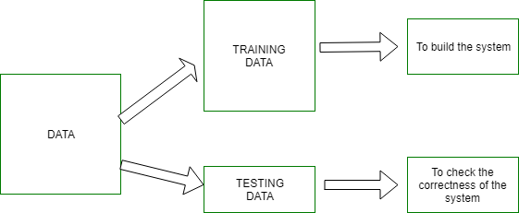
Conti..

Slide 12
Advantages & Disadvantages:
Pattern recognition solves classification problems
Pattern recognition solves the problem of fake biometric detection.
It is useful for cloth pattern recognition for visually impaired blind people.
It helps in speaker binarization.
We can recognize particular objects from different angles.
The syntactic pattern recognition approach is complex to implement and it is a very slow process.
Sometimes to get better accuracy, a larger dataset is required.
It cannot explain why a particular object is recognized. Example: my face vs my friend’s face.

Slide 13
Applications:
Image processing, segmentation, and analysis Pattern recognition is used to give human recognition intelligence to machines that are required in image processing.
Computer vision Pattern recognition is used to extract meaningful features from given image/video samples and is used in computer vision for various applications like biological and biomedical imaging.
Seismic analysis The pattern recognition approach is used for the discovery, imaging, and interpretation of temporal patterns in seismic array recordings. Statistical pattern recognition is implemented and used in different types of seismic analysis models.
Radar signal classification/analysis Pattern recognition and signal processing methods are used in various applications of radar signal classifications like AP mine detection and identification.
Speech recognition The greatest success in speech recognition has been obtained using pattern recognition paradigms. It is used in various algorithms of speech recognition which tries to avoid the problems of using a phoneme level of description and treats larger units such as words as pattern
Fingerprint identification Fingerprint recognition technology is a dominant technology in the biometric market. A number of recognition methods have been used to perform fingerprint matching out of which pattern recognition approaches are widely used.

Slide 14

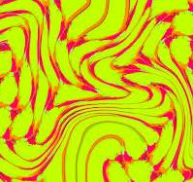
Pattern Distortions-
Pattern-Distortion Technique: Using Liquid-Lens Magnification to Extract Volumes of Individual Droplets or Bubbles within Evaporating Two-Dimensional Arrays.
Pattern distortions in the context of pattern recognition refer to alterations or deviations in the expected pattern, which can complicate the task of correctly identifying or classifying the pattern. These distortions can be caused by various factors, such as noise, geometric transformations, occlusions, or variations in the pattern itself.

Slide 15
Conti..
The Pattern-Distortion Technique is a method used in therapy to help people change negative or unhelpful thought patterns. Here’s how it works in simple terms:
Identify Negative Thoughts: First, you recognize thoughts that are causing distress or holding you back.
Challenge the Thoughts: Next, you examine these thoughts to see if they're based on facts or assumptions. Often, negative thoughts can be exaggerated or not entirely true.
Change the Perspective: You then try to see things from a different angle. This might involve questioning whether there’s evidence to support the negative thought or considering alternative viewpoints.
Replace with Balanced Thoughts: Finally, you replace the negative thought with a more balanced or realistic one. This helps to reduce distress and improve your overall outlook.
Overall, it's a way to reframe how you think about things, helping you feel better and think more positively.

Slide 16
Key Concepts
Geometric Distortions:
Translation: Moving the pattern from one location to another.
Rotation: Rotating the pattern by some angle.
Scaling: Changing the size of the pattern.
Shearing: Skewing the pattern in one direction.
Reflection: Flipping the pattern over a line.

Slide 17
Conti..
Noise:
Random variations in the pattern that can obscure or alter its appearance.
This can be caused by sensor imperfections, environmental factors, or data corruption.
Occlusions:
Parts of the pattern are hidden or covered, making it incomplete or partially visible.
Variability:
Natural variations within the same class of patterns.
For example, different handwriting styles for the same character.

Slide 18
Example:
Let's consider a simple example of a geometric distortion:
Original Pattern:
An image of a letter 'A’.
Distorted Patterns:
Translation: The letter 'A' is moved to a different position within the image.
Rotation: The letter 'A' is rotated by 30 degrees.
Scaling: The letter 'A' is resized to be smaller or larger.
Shearing: The letter 'A' is skewed, making it appear slanted.

Slide 19
Handling Distortions in Pattern Recognition
Preprocessing:
Normalize the patterns to a standard form (e.g., resizing, aligning, or centering).
Apply noise reduction techniques to mitigate the impact of noise.
Feature Extraction:
Extract features that are invariant to the distortions
. For example, using edge detection can help identify shapes regardless of their position or size.
Robust Algorithms:
Use algorithms that can handle variations and distortions,
such as convolutional neural networks (CNNs) in image recognition tasks.
Data Augmentation:
Generate distorted versions of the training data to improve the robustness of the pattern recognition
model.

Slide 20
Features Extraction Using Generalized Cylinders for 3-D object Description and Classification:
Features Extraction Using Generalized Cylinders for 3-D Object Description and Classification" is a technique used in computer vision and pattern recognition to analyze and categorize three-dimensional objects.
1. Generalized Cylinders
Concept: Objects in the real world can often be approximated or described as being composed of cylindrical shapes. These cylinders can vary in size, orientation, and other properties.
Application: In this technique, each part of a 3-D object is represented as a generalized cylinder. These cylinders can capture the overall shape and structure of the object.

Slide 21
Conti..
2. Features Extraction
Process: The technique involves extracting specific features from these generalized cylinders. These features could include parameters such as the radius, length, orientation, and position of each cylinder within the 3-D space.
Purpose: By extracting these features, the method creates a descriptive representation of the object based on its cylindrical components. This representation is more abstract and focused on the object's structural elements rather than detailed surface textures.

Slide 22
Conti..
3. Object Description
Representation: Using the extracted features, the 3-D object is described in terms of these generalized cylinders. This description provides a simplified yet informative way to understand the object’s overall shape and geometry.
4. Classification
Utilization: Once the object is described using the generalized cylinders and their features, classification algorithms can be applied. These algorithms analyze the extracted features to categorize or classify the object into predefined classes or types.

Slide 23
Advantages and Applications
Advantages: This approach is beneficial because it reduces the complexity of 3-D object analysis by focusing on fundamental geometric shapes (cylinders), which are easier to handle computationally.
Applications: It finds applications in various fields such as robotics (object recognition and manipulation), computer-aided design (CAD), medical imaging (3-D organ recognition), and augmented reality (object interaction and manipulation).
Features Extraction Using Generalized Cylinders for 3-D Object Description and Classification" technique leverages generalized cylinders to simplify the representation and classification of 3-D objects based on their geometric shapes and structural components. It’s a powerful tool in computer vision for understanding and interacting with complex real-world objects in a computationally efficient manner.

Slide 24
Example:
Input 3D Object:
A 3D object, such as a human arm, can be represented using
generalized cylinders for different segments (upper arm,
forearm, hand).
Decomposition:
Decompose the arm into three segments: upper arm, forearm,
and hand.
Spine Detection:
Detect the central axis of each segment using skeletonization techniques.

Slide 25
Conti..
Cross-Sectional Profile Extraction:
Extract the cross-sectional profile at different points along the spine. For simplicity, assume the profiles are circular.
Parameterization:
Measure the radius of the cross-section at different points along the spine and the curvature of the spine.
Feature Vector Construction:
Construct a feature vector comprising the radius and curvature values for each segment.
Classification:
Use machine learning algorithms to classify the object based on the extracted feature vectors.

Slide 26
Application:
Medical Imaging:
Used in medical imaging to describe and classify anatomical structures such as blood vessels and bones.
Robotics:
Useful in robotic vision for object recognition and manipulation.
Industrial Inspection:
Applied in industrial inspection to recognize and classify components and structures.

Slide 27
Advantages and Challenges-
Advantages:
Compact Representation:
Generalized cylinders provide a compact and efficient way to represent complex 3D shapes.
Robustness to Noise:
The representation is robust to noise and minor variations in the object shape.
Intuitive:
The method aligns with human perception of tubular structures, making it intuitive for certain types of objects
Challenges:
Complex Shapes:
Representing highly complex or non-tubular shapes using generalized cylinders can be challenging.

Slide 28
Generating RST Invariant Features and Application to 2-D Figure Recognition:
Generating RST (Rotation, Scale, Translation) invariant features is a technique used in pattern recognition and computer vision to enable accurate recognition of objects despite changes in their orientation, size, or position.
1. Understanding RST Invariance
Definition: RST refers to Rotation, Scale, and Translation, which are common transformations that can change the appearance of an object in an image.
1. Rotation
Definition: Rotation refers to the angular displacement of an object around a specific point, often the center of the object or the origin of the coordinate system.
Effect on Appearance: When an object undergoes rotation:
Shape: The shape of the object remains the same, but its orientation changes.
Pixel Positions: The positions of pixels defining the object's boundary or structure change relative to the coordinate system.
Example: Imagine a square. Rotating it by 90 degrees clockwise transforms its original horizontal edges into vertical ones, altering how it appears in an image.

Slide 29
Conti..
2. Scale
Definition: Scale involves resizing an object uniformly in all directions, either making it larger (zoom in) or smaller (zoom out).
Effect on Appearance: Scaling affects the:
Size: The physical dimensions of the object change.
Detail: Details within the object might be magnified or reduced, affecting its appearance in terms of resolution and clarity.
Example: Scaling a circle down makes it smaller in size while maintaining its circular shape.

Slide 30
Conti…
3. Translation
Definition: Translation refers to shifting an object's position horizontally and/or vertically within the image plane.
Effect on Appearance: When an object is translated:
Position: Its location relative to the image frame changes.
Pixel Coordinates: Every pixel defining the object's boundary or structure is shifted by the specified amount.
Example: Moving a triangle to the right by 10 pixels shifts its entire outline horizontally without altering its shape or size.

Slide 31
CONTI..
4. Combined Effects
Simultaneous Transformations: In real-world scenarios, objects often undergo combinations of these transformations simultaneously.
Example: An image of a car might appear rotated, scaled smaller, and shifted slightly to the left relative to its original position in a reference image
.
5. Importance in Image Processing
Challenges: Recognizing and analyzing objects in images becomes challenging due to variations caused by RST transformations.
Solution: To address these challenges, algorithms are designed to extract features from objects that remain invariant or unaffected by RST transformations. This ensures accurate object recognition regardless of changes in orientation, size, or position.

Slide 32
Conti..
Generating RST Invariant Features
Feature Extraction: The process involves identifying and extracting features from the object that are insensitive to rotations, scalings, and translations. Some common methods for generating RST invariant features include:
Moment Invariants: These are statistical measures of the object's shape that remain constant under RST transformations. Moments capture information about the distribution of pixel intensities within the object.
Fourier Descriptors: These represent the shape of the object in the frequency domain, making them invariant to translation, rotation, and scaling. They capture the object's boundary or outline information.
Invariant Histograms: Histograms of gradient orientations or texture features that are insensitive to RST transformations can also be used as invariant features.

Slide 33
Conti..
Application to 2-D Figure Recognition
Process: Once RST invariant features are extracted from a set of training images:
Training: These features are used to train a recognition model (e.g., a classifier such as SVM or neural network).
Testing: During testing or recognition phase, features are extracted from the input image containing the object to be recognized.
Matching: The extracted features from the input image are compared with the features stored in the training set. Because the features are invariant to RST transformations, the system can accurately identify the object even if it appears in a different orientation, size, or position.

Slide 34
Challenges and Considerations
Computational Complexity: Generating and matching invariant features can be computationally intensive, especially for large datasets or real-time applications.
Feature Design: Choosing appropriate invariant features that capture the essential characteristics of the object while remaining invariant to RST transformations is crucial for the success of the recognition system.

Slide 35
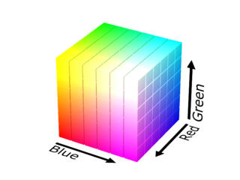
The Feature Vector and Feature Space :
Feature: A feature is a numerical or symbolic property of an aspect of an object. A feature vector is a vector containing multiple elements about an object. Putting feature vectors for objects together can make up a feature space.
Feature Vector:
Definition: A feature vector is an n-dimensional vector of numerical features that represent some object or phenomenon being analyzed. In simpler terms, it's a structured representation of data that captures relevant characteristics or attributes.
In machine learning, feature vectors are used to represent numeric or symbolic characteristics, called features, of an object in a mathematical, easily analyzable way. They are important for many different areas of machine learning and pattern processing. Machine learning algorithms typically require a numerical representation of objects in order for the algorithms to do processing and statistical analysis. Feature vectors are the equivalent of vectors of explanatory variables that are used in statistical procedures such as linear regression.
An example of a feature vector you might be familiar with is RGB (red-green-blue) color descriptions. A color can be described by how much red, blue, and green there is in it. A feature vector for this would be color = [R, G, B].

Slide 36
Feature Vector:
A feature vector is a set of measurable characteristics or properties that describe an object or instance. Each element in the feature vector represents a specific attribute of the object.
For example, consider an image recognition system trying to identify flowers. A feature vector for a flower might include attributes like petal length, petal width, sepal length, and sepal width. If we have a flower with petals 5 cm long and 3 cm wide, and sepals 2 cm long and 1 cm wide, the feature vector could be represented as [5,3,2,1][5, 3, 2, 1][5,3,2,1].

Slide 37
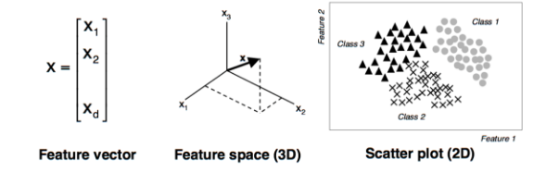
Explanation:
A vector is a series of numbers, like a matrix with one column but multiple rows, that can often be represented spatially. A feature is a numerical or symbolic property of an aspect of an object. A feature vector is a vector containing multiple elements about an object. Putting feature vectors for objects together can make up a feature space.
The features may represent, as a whole, one mere pixel or an entire image. The granularity depends on what someone is trying to learn or represent about the object. You could describe a 3-dimensional shape with a feature vector indicating its height, width, depth, etc.

Slide 38
Feature Space:
The feature space is the multidimensional space where each
dimension corresponds to one of the features in the feature vector.
Each point in this space represents a unique combination of feature values.
Example:
If we have four features, the feature space would be a four-dimensional space.
Each flower can be plotted as a point within this space based on its feature vector.
The position of the flower in this space helps in distinguishing it from other flowers.

Slide 39
Uses of Feature Vectors
Feature vectors are used widely in machine learning because of the effectiveness and practicality of representing objects in a numerical way to help with many kinds of analyses. They are good for analysis because there are many techniques for comparing feature vectors. One simple way to compare the feature vectors of two objects is to take the Euclidean distance.
In image processing, features can be gradient magnitude, color, grayscale intensity, edges, areas, and more. Feature vectors are particularly popular for analyses in image processing because of the convenient way attributes about an image, like the examples listed, can be compared numerically once put into feature vectors.
In speech recognition, features can be sound lengths, noise level, noise ratios, and more.
In spam-fighting initiatives, features are abundant. They can be IP location, text structure, frequency of certain words, or certain email headers.

Slide 40
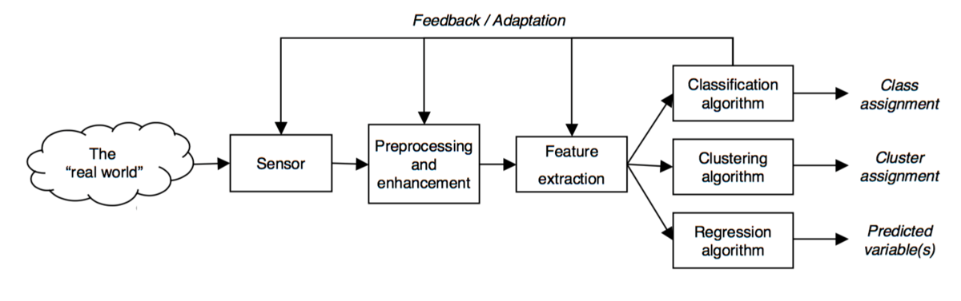
In pattern recognition processes, feature vectors are the tools used between gathering data, and making sense of the data:

Slide 41
Classifiers, Decision Regions and Boundaries and Discriminant Functions:
Classifiers-
Definition: A classifier is a function or model that assigns a class label to input data based on learned patterns from training examples. It distinguishes between different categories or classes by mapping input features to a predicted class label.
Types: Common types of classifiers include:
Binary Classifiers: Distinguish between two classes (e.g., yes/no, spam/not spam).
Multi-class Classifiers: Assign one of multiple classes to input data (e.g., identifying different types of animals).
Example: In email spam detection, a classifier might analyze email content and header information to classify emails as either spam or not spam based on learned patterns from previously labeled examples.

Slide 42
Definition: Classifier
A classifier is an algorithm or model that categorizes or labels data
points based on their feature vectors.
It takes the feature vector as input and outputs a class label
indicating the category to which the object belongs.
For example,
In a flower classification system,
a classifier might use the feature vector [5,3,2,1][5, 3, 2, 1][5,3,2,1]
to decide whether the flower is a rose, tulip, or daisy.

Slide 43
Example
Suppose we have a simple classifier that uses the height and width of a flower to determine its type. If we have a dataset of labeled flowers, the classifier can learn from this data and make predictions about new flowers based on their measurements.

Slide 44
Decision Regions and Boundaries:
Decision Region: In a classifier, the decision region is the area of the feature space where all points are assigned to the same class label. It is determined by the classifier’s decision rule or discriminant function.
Decision regions are specific areas within the feature space where the classifier assigns the same label to all data points within that region.
For instance, in a 2D feature space with features like petal length and width, the decision regions might separate areas where the classifier labels flowers as either roses, tulips, or daisies.

Slide 45
Decision Boundary
The decision boundary is the boundary or surface that separates different decision regions in the feature space. It defines the transition between assigning one class label versus another.
Example: Consider a binary classifier separating two classes (e.g., cats and dogs) based on features like height and weight. The decision boundary might be a line or curve in the feature space where points on one side are classified as cats and points on the other side as dogs.

Slide 46
Conti..
Decision boundaries are the borders that separate different decision regions.
These boundaries define where the classifier changes from predicting one class to another.
In our flower example,
the decision boundary might be a line that separates roses from tulips based on petal length and width. If a flower's feature vector falls on one side of the boundary, it is classified as a rose; if it falls on the other side, it is classified as a tulip

Slide 47
Discriminant Functions:
Definition: A discriminant function is a function that maps input features to a class label or a score that indicates the likelihood of belonging to a particular class. It quantifies the relationship between input data and class labels based on learned parameters.
Formulation: Discriminant functions can take various forms depending on the classifier used:
Linear Discriminant Functions: Classify data using linear combinations of input features (e.g., linear SVM, linear discriminant analysis).
Non-linear Discriminant Functions: Capture complex relationships between features and classes using non-linear transformations (e.g., kernel SVM, neural networks).
Usage: During classification, the discriminant function evaluates input features and outputs a decision that maximizes the classifier’s accuracy in assigning class labels.

Slide 48
Definition:
A discriminant function is a mathematical function used by classifiers to assign a class label to a given feature vector. It evaluates the input feature vector and outputs a value that indicates the class of the data point.
Example:
In the context of our flower classification, the discriminant function might be used to determine whether a flower is a rose or tulip based on its petal and sepal measurements. The function will produce a score, and based on this score, the classifier will assign the appropriate class label.

